Slide 1

SQL queries
List user-ID such that it gives book rating < 5 and live in Baton Rouge, Louisiana, USA
select u.`User-Id`
from `BX-Users` u, `BX-Book-Ratings` r
where (u.`User-Id`=r.`User-Id`) and (r.`Book-Rating`< 5) and (u.`Location`='baton rouge, louisiana, usa');

Slide 2
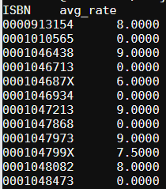
SQL queries
Get ISBN and average rate of books which published before 2000.
select `ISBN`, avg(`Book-Rating`) as avg_rate
from (select r.`ISBN`,r.`Book-Rating`
from `BX-Book-Ratings` r, `BX-Books` b
where (r.`ISBN`=b.`ISBN`) and (b.`Year-Of-Publication`< 2000)) as y
group by `ISBN`;

Slide 3
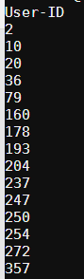
SQL queries
List user-ID such that the user’s age < 30 and gives average book rate < 5
select age.`User-ID`
from (select u.`User-ID`
from `BX-Users` u
where `Age` < 30) as age
inner join (select r.`User-ID`, avg(r.`Book-Rating`)
from `BX-Book-Ratings` r
group by r.`User-ID`
having avg(r.`Book-Rating`) < 5 ) as rate
on age.`User-ID`=rate.`User-ID`;

Slide 4
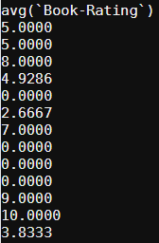
SQL queries
Get average rate of books which written by male author
select avg(`Book-Rating`)
from (select r.`Book-Rating`,r.`ISBN`
from `BX-Book-Ratings` r, `BX-Authors` a, `BX-Books` b
where (r.`ISBN`=b.`ISBN`) and (b.`Book-Author`=a.`Name`) and (a.`Gender`='Male')) as y
group by `ISBN`;

Slide 5
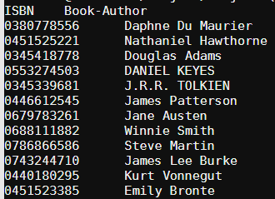
SQL queries
List all ISBN and Book-Author of books rated by user living in Baton Rouge, Louisiana, USA.
select distinct b.`ISBN`,b.`Book-Author`
from `BX-Books` b, `BX-Book-Ratings` r, `BX-Users` u
where (b.`ISBN`=r.`ISBN`) and (r.`User-ID`=u.`User-ID`) and (u.`Location`='baton rouge, louisiana, usa');

